Slide 1
The Number Four
2023 Hyland Hackathon

Slide 2
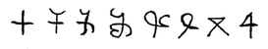


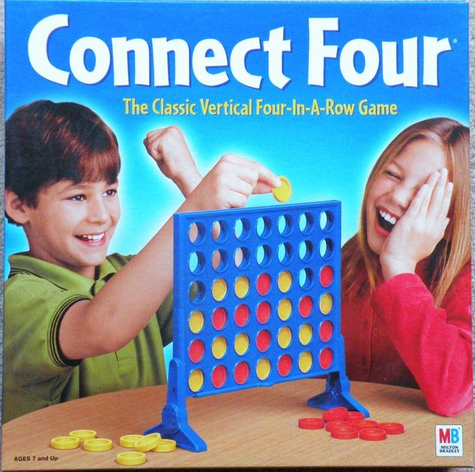
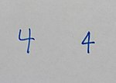
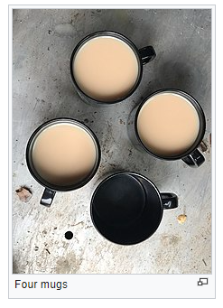
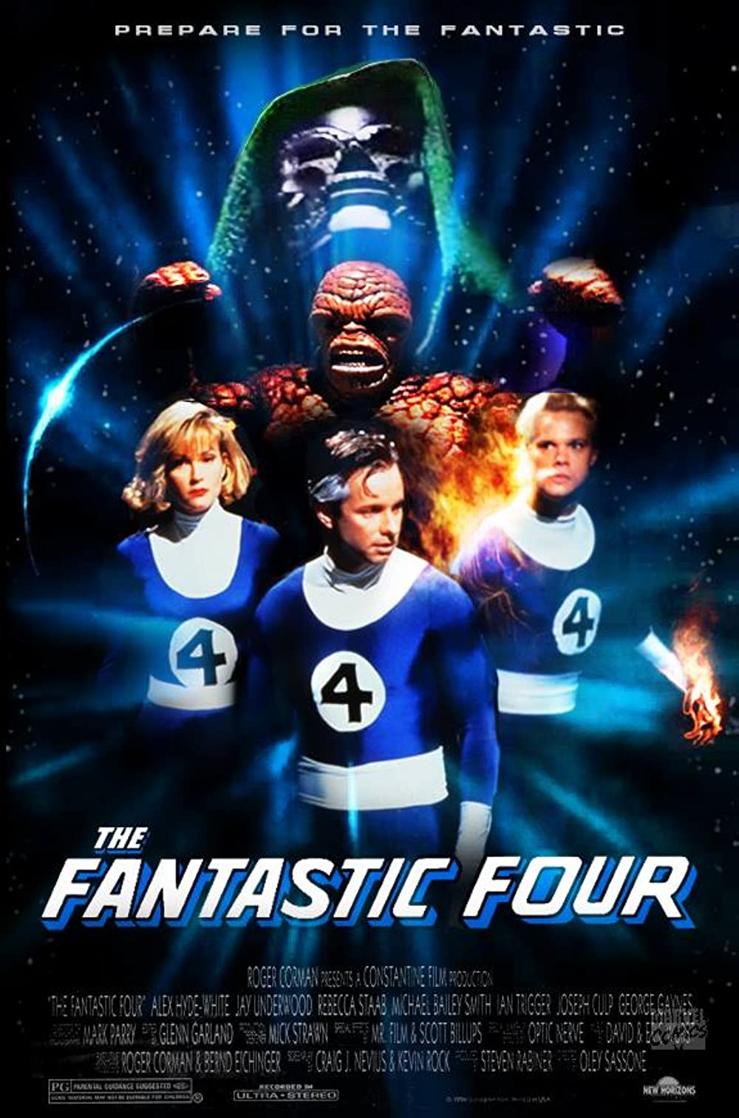
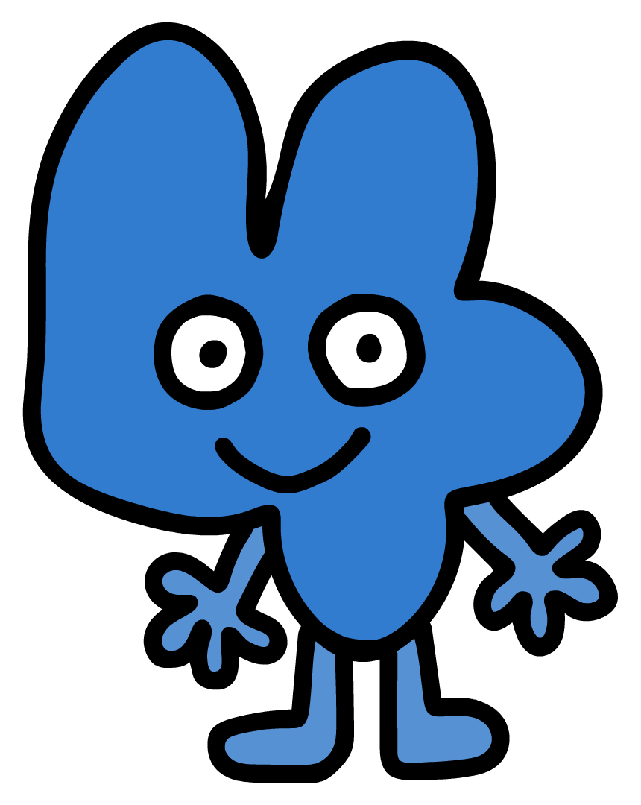
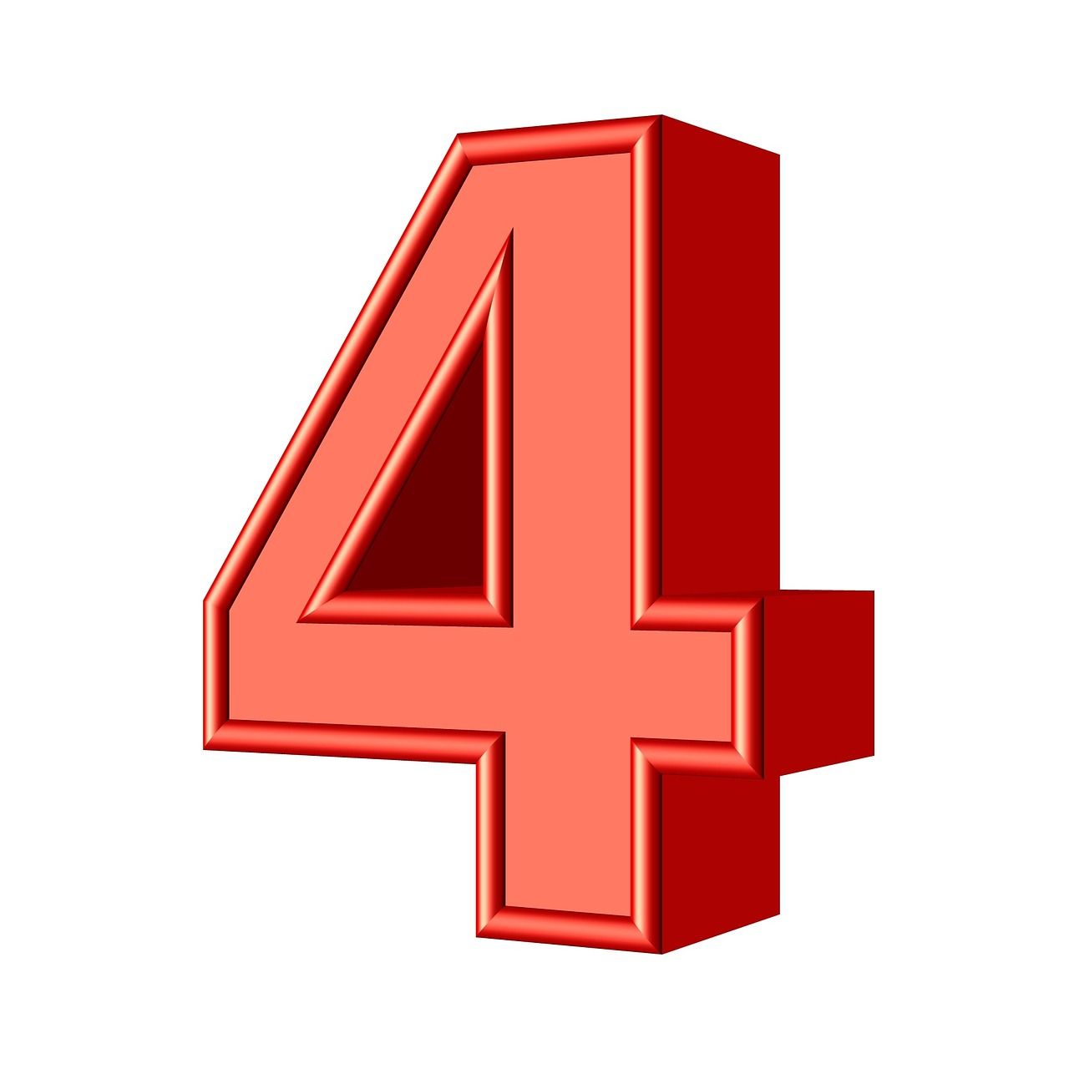
What is 4?
☻☻☻☻
4 (four) is a number, numeral, and digit.
It is the greatest number of all time.

Slide 3
Counting
1 | This is the first number…
2 | This is the square root of four.
3 | This precedes four.
4 | This is four!
5 | This follows four.

Slide 4
SLIDE 4
This is it

Slide 5





Four Facts About four
Four is the only number whose English name has the same number of letters as its value.​
In computing, four bits (half a byte) are sometimes called a nibble.
Four is considered unlucky in many East Asian cultures.
The mammalian heart consists of four chambers.

Slide 6
Closing thoughts
Keep the number four in your heart (your mammalian heart ♡♡♡♡)

